Slide 1
Organizational
Culture

Slide 2
Institutionalization:
A Forerunner of Culture
Institutionalization
When an organization takes on a life of its own, apart from any of its members, becomes valued for itself, and acquires immortality.
Institutionalisation operates to produce a common understanding among members about what is appropriate and meaningful and acceptable modes of behaviour.

Slide 3
What Is Organizational Culture?
Organizational Culture
A common perception held by the organization’s members;
a system of shared meaning.
Characteristics that captures the essence of an organisation’s culture
Innovation and risk taking
Degree to which employees are encouraged to take risks ad be innovative
Attention to detail
degree to which employees are expected to be precise, analytical and pay attention to detail

Slide 4
What Is Organizational Culture?
Outcome orientation
Degree to which management focuses on the results rather than techniques or processes used to achieve those results
People orientation
Degree to which management takes into consideration the effect of outcome on the individual
Team orientation
Degree to which work is organised around teams rather than individuals

Slide 5
What Is Organizational Culture?
Aggressiveness
Degree to which people are aggressive and competitive rather than easy going
Stability
Degree to which organisational activities emphasize on maintaining the status quo rather than change to grow
Appraising an organisation on the basis of these 7 characteristics gives an overall view of the organisational culture
the feelings of shared understanding
how things are done in the organisation
how members are supposed to behave

Slide 6
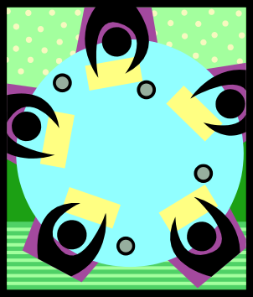

Do Organizations Have Uniform Cultures?
Dominant Culture
Expresses the core values that are shared by a majority of the organization’s members.
Subcultures
Minicultures within an organization, typically defined by department designations and geographical separation.

Slide 7

Strong Cultures
Strong Culture
A culture in which the core values are intensely held and widely shared.
Result of strong culture
Lower employee turnover
Higher agreement among members about what the organisation stands for
Cohesiveness
Loyalty
commitment
Core Values
The primary or dominant values that are accepted throughout the organization.

Slide 8
Culture Versus Formalization
  A strong culture increases behavioral consistency and can act as a substitute for formalization
    formalization = rules & regulations to guide employee behaviour
    high formalization creates predictability, orderliness, consistency
Organizational Culture Versus National Culture
  National culture has a greater impact on employees than does their organization’s culture.
  Nationals selected to work for foreign companies may be different of the local/native population and better fit for the organisation’s culture.

Slide 9
What Do Cultures Do?
Culture’s Functions:
Defines the boundary between one organization and others.
Conveys a sense of identity for its members.
  Southwest employees : fun and joking around
Facilitates the generation of commitment to something larger than self-interest.
  Get away from ‘what’s in it for me’ to ‘what can I do to help’?
Enhances the stability of the social system…culture is like a social glue that holds organisations together
It guides and shapes the behaviour and attitude of employees
  For example, when culture is about customer satisfaction – do all you can
As organisations have widened spans of control, flattened structures, introduced teams, reduced formalization, empowered employees…the shared meaning provided by a strong culture points everyone to the same direction

Slide 10
Culture as a Liability:
Barrier to change
An entrenched culture may be inappropriate for a fast changing environment – Mitsubishi, Boeing, Eastman Kodak, Hindustan Motors
cannot be business as usual
Barrier to diversity
Hiring on the basis of age, race, gender, disability, etc., those who are in minority are forced to conform by strong cultures…instead of bringing the differences into the organisation
Barrier to acquisitions and mergers
Other than financial advantage or synergy, a good cultural compatibility is important for the new entity to survive…AOL – Time Warner ($183 b merger 2001)‏

Slide 11
Creating & sustaining cultures
How Culture Begins
The ultimate source of an organisation’s culture = its founders
Founders hire and keep only employees who think and feel the same way they do.
Founders indoctrinate and socialize these employees to their way of thinking and feeling.
The founders’ own behavior acts as a role model that encourages employees to identify with them and thereby internalize their beliefs, values, and assumptions.

Slide 12
Sustaining cultures
Selection
  Concern with how well the candidates will fit into the organization.
  Provides information to candidates about the organization.
Top Management
  Senior executives help establish behavioral norms that are adopted by the organization.
  Through what they say and how they behave, senior executives establish norms that filter down
Socialization
  The process that helps new employees adapt to the organization’s culture.

Slide 13
Stages in the Socialization Process
Pre-arrival Stage
The period of learning in the socialization process that occurs before a new employee joins the organization.
Encounter Stage
The stage in the socialization process in which a new employee sees what the organization is really like and confronts the possibility that expectations and reality may diverge.
Metamorphosis Stage
The stage in the socialization process in which a new employee changes and adjusts to the work, work group, and organization.

Slide 14
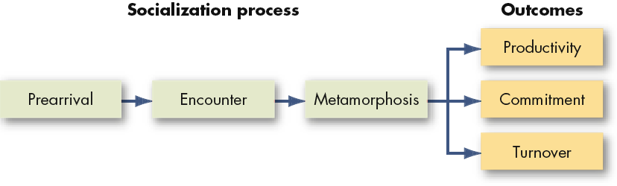
A Socialization Model

Slide 15
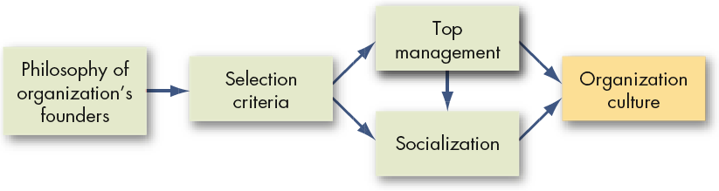
How Organization Cultures Form

Slide 16
How Employees Learn Culture
Stories
    Nike’s Bill Bowerman – spirit of innovation [Steve Prefontaine’s battle to make running a professional sport – Nike’s commitment to help athletes]
    Stories anchor the present in the past and legitimises the current practices
  Slogans
    Catchy phrases that companies use to capture customers’ attention to their products. [It’s not TV. Its HBO. Its not oil. Its liquid engineering]
Rituals
  Repetitive sequences of activities that expresses and reinforce key values of the organisation – e.g. Company chant – IBM, Novell
Material Symbols
  Office layout can be informal = openness, equality, flexibility, creativity
  The size of the office, furnishings, attire, perks, etc.
Language
  Jargon of the organisation related to its products, customers, suppliers, key people
  This terminology acts as a common denominator that unites members to the culture.

Slide 17
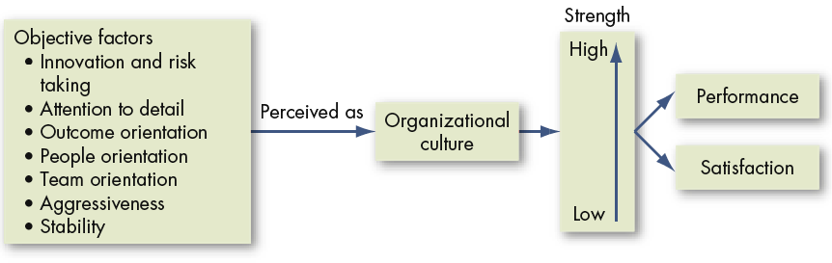
How Organizational Cultures Have an Impact on Performance and Satisfaction

